Slide 1
Holiday Cyber Buying and Security
Prepared by: Benjamin Dalton,

Slide 2
Holiday Cyber Buying Topics
Holiday Scams
Passwords
Internet Safety
Device Safety

Slide 3
Holiday Season Stats
Black Friday: Millions of holiday shoppers
2022; American shoppers spent over $9 billion
Holiday season attracts scammers
127% higher that any point in the year
2022 Consumers lost $8 billion to scams

Slide 4

Holiday Offers Too Good to be True
Steep Discounts
Social Media Items
Cheap Airfare

Slide 5
Red Flags of Phishing
Urgent or Threatening Language
Missed Delivery Notifications
Request for Sensitive Information
Unexpected Order Confirmation
Offers Too Good To Be True
Request for Gift Card

Slide 6
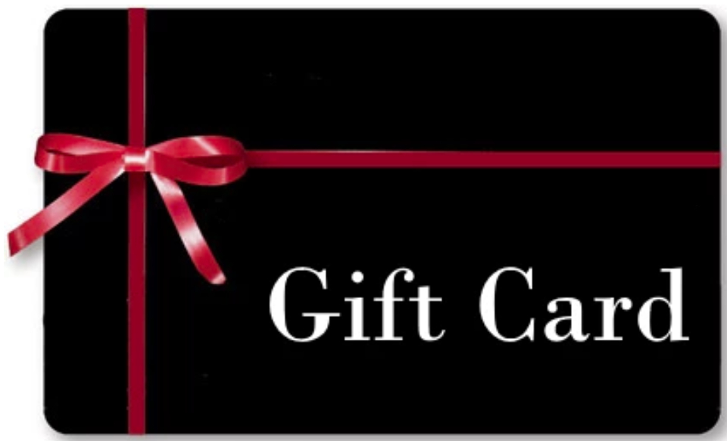
Gift Card Scams
Discounted Gift Cards Scam (empty cards)
Purchase from Trusted Retailers
Check for Tampered Cards
Requests to Pay with Gift Card

Slide 7
Holiday Scams:
Fake Job Scams (seasonal jobs)
Claiming to be the Government
Tech Support Scams
Won a Prize
Deposit Check and Send the Difference
Notes:
Maybe able to get any left over money on the card. Treat gift cards like money

Slide 8
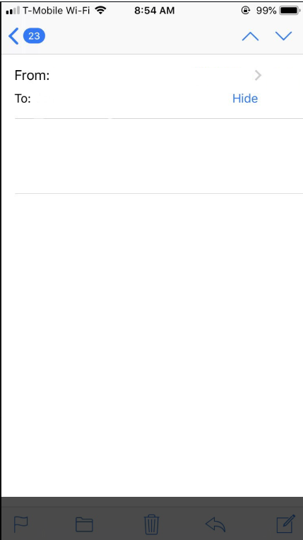
Naomi Smith <office321.csc.eu@gmail.com>
[EXTERNAL] Humanitarian Job Has Just Been Suggested For You!
*** This email originated from outside the Columbus State email system. ***
Please exercise caution when clicking links or attachments within this email or responding to requests for personal data. Never act on gift card requests.
CSCC has been selected among the most valuable colleges in the US, to support orphanages with creating job opportunities for staff and students to support the World Vision Child Sponsorship donation.
Job/Position: Children Care Support & Personal Aid
Hours: 2-3 hours daily
Compensation: $550 weekly

Slide 9
Fake Charity Scam
Research the charity name online
Consider well-known charities
Check charity is legit; BBB recommends charitywatch.org
Report Charity Scams by contacting the FBI’s Internet Crime Complaint Center (IC3) and the Federal Trade Commission
Notes:
Maybe able to get any left over money on the card. Treat gift cards like money

Slide 10
Fake Order Scam
Phishing email tricks you into:
Downloading malicious files
Sharing passwords, personal information and/or credit card numbers
Notes:
Maybe able to get any left over money on the card. Treat gift cards like money

Slide 11

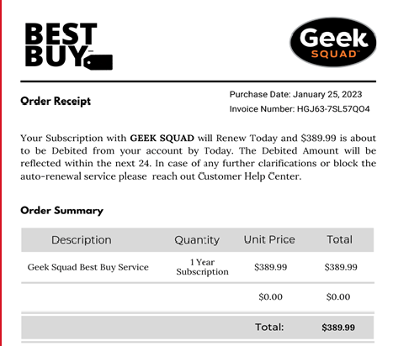

Slide 12
Account Verification Scam
Close Browser, Delete history
Scan computer for malware
Update your software
Change any affected passwords
Monitor your accounts
Notes:
Maybe able to get any left over money on the card. Treat gift cards like money

Slide 13
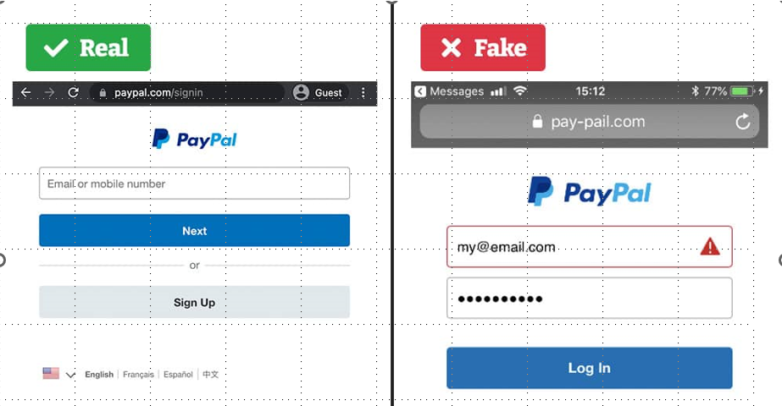
Fake Websites
Paypal.com/signin
Pay-pail.com

Slide 14
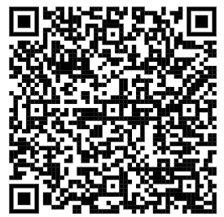
QR Codes
Examine the URL
Paypal.com/signin
Pay-pail.com

Slide 15
Strong Passwords Contain
Minimum of 12 characters
Uppercase characters (e.g., A-Z)
Lowercase characters (e.g., a-z)
Numbers (e.g., 0-9) and/or special characters (e.g., !, #, $, %)

Slide 16

General Internet Safety Tips
Keep personal information secure and limit sharing
Keep your privacy settings on
Avoid using public free Wi-Fi
Be careful what you download
Purchase from secure sites

Slide 17
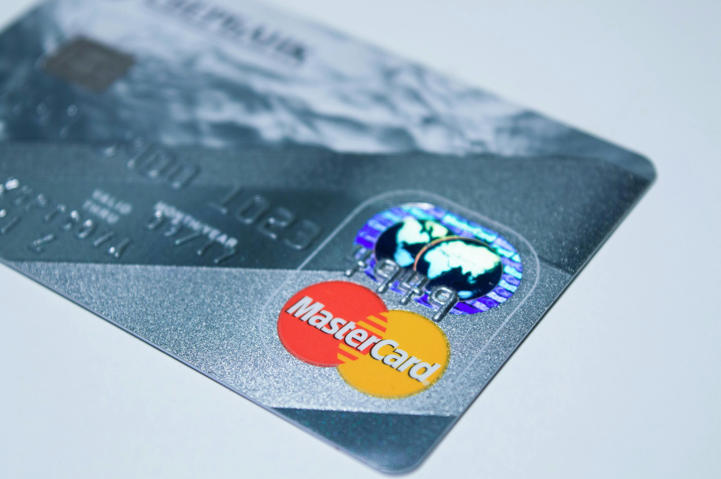
Online Safe Payment Method
Paying by credit card protects your money in case of a scam

Slide 18
Protecting Your Computer
Antivirus
Firewalls
Patching and Updates
Change Default Password
For more info visit our website:
www.cscc.edu/employee/technology/it-security

Slide 19
Mobile Devices
Lock your phone
Avoid USB charging in public places
Limit activities on public Wi-Fi networks
Review app permissions before installing
Keep apps and software up-to-date

Slide 20
Closing
Research retailers before shopping
Use strong passwords
Be wary of unfamiliar emails and texts
Monitor your bank accounts
Use credit card for online purchases
Enable multifactor authentication

Slide 21
Kahoot Game

Slide 22
Report Security Issues
IT Support Center
(614) 287-5050
helpdesk@cscc.edu
Report Phishing
abuse@cscc.edu
In-Person Support
Computer Common TL116

Slide 23

Questions?

